Slide 1

Document
Object
Model
access101

Slide 2
HTML + CSS =
static
site(s)
access101

Slide 3
?
What about
Interactivity
access101

Slide 4
Javascript
to the rescue.
access101

Slide 5
How to?
HTML + CSS + Javascript
access101

Slide 6
Document
Object
Model
access101

Slide 7
The Document Object Model (DOM) is a programming interface for HTML and XML documents.
It represents the page so that programs can change the document structure, style, and content.
The DOM represents the document as nodes and objects. That way, programming languages can connect to the page.
access101

Slide 8
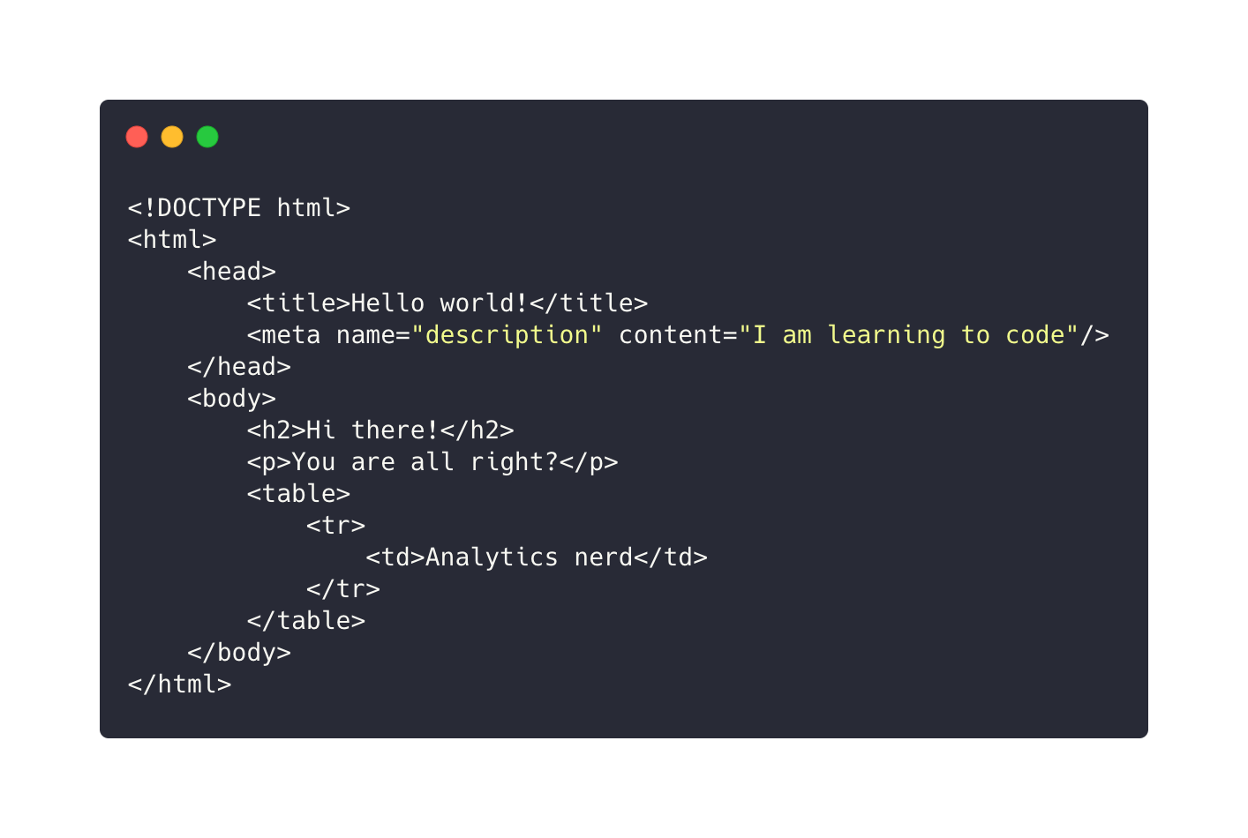
access101

Slide 9
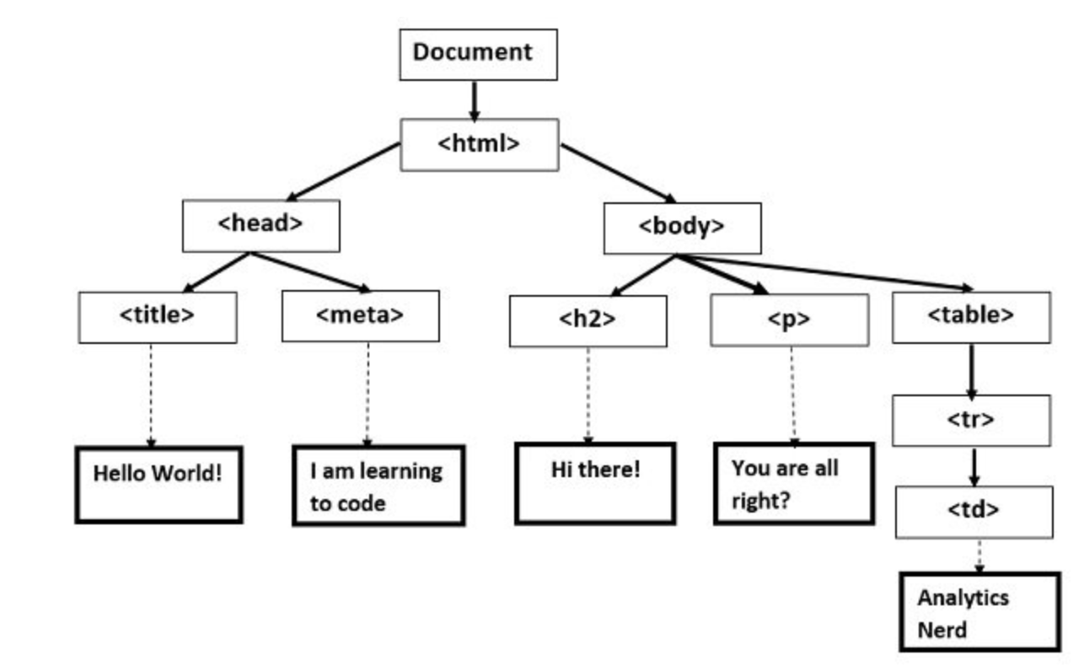
access101

Slide 10
document.
access101

Slide 11
DOM manipulation
using Javascript.
access101

